Slide 1
ALY 6070 Communication and Visualization for Data Analytics
The Importance of Context

Slide 2
Exploratory vs. Explanatory
Exploratory analysis is what you do to understand the data and figure out what might be noteworthy or interesting to highlight to others
  Fishing in the Ocean – not sure exactly what you’ll find
Explanatory analysis – you have a specific story you want to tell
  This course is really about communication
  A picture is worth a thousand words
  Sometimes a picture is too complicated, just stick with words
  Presenting your analysis means conveying key insight while knowing the details to back up your story if questions get asked

Slide 3
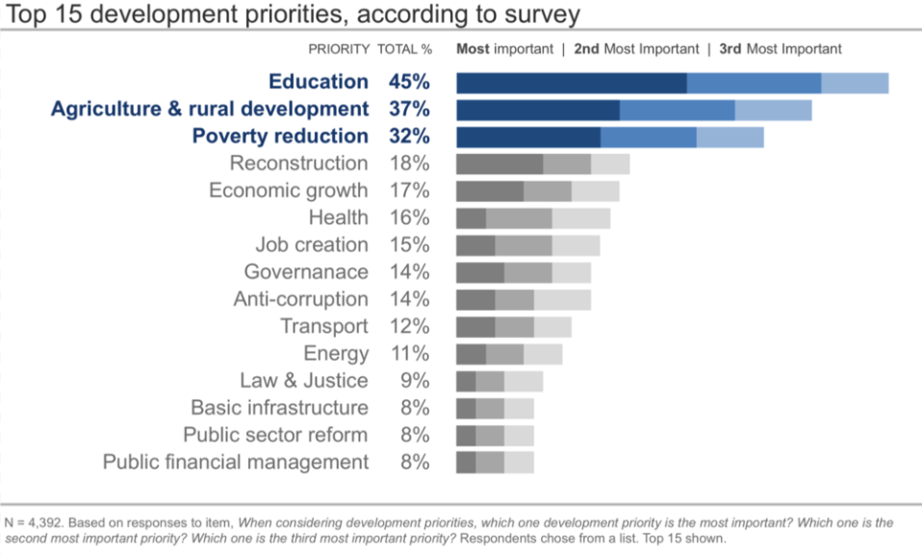
What is the story?
https://www.storytellingwithdata.com/?offset=1515608010379

Slide 4
Who is the Audience?
Who is the intended recipient of the data visualization?
  Executives – keep it high level
  Finance – including detail in tables.
  Technical – can include three decimals, e.g 0.832 vs. 0.8 or just 1
What is their background?
  How busy are they and how much time do they have to devote to your presentation?
  How many individuals are expected to be in the room when you present?
  Will you email your data visualization? What are the odds it gets forwarded to others?

Slide 5
What is the Action?
When designing an explanatory data visualization, the goal is to make a recommendation or plan of action.
  You want to prompt your audience to make a decision, e.g. to continue or discontinue a program.
  Highlight a variation that is of interest to the group
At the very least you want to highlight a specific problem to draw their attention, to prompt further discussion.
Suggest next steps at the end of your talk. Keep a sense of forward momentum

Slide 6
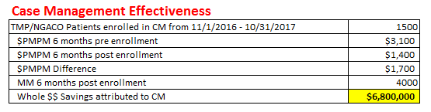
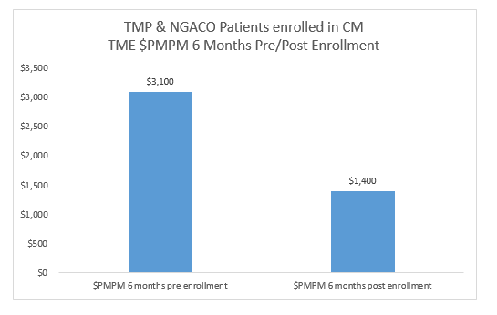
Recommendation: program is showing successful reduction in costs, we should maintain it or expand it to other patient cohorts

Slide 7
How will you communicate with your audience?
Live Presentation Keep slides sparse with not too much detail. You would need to speak to your key points rather than having the audience listen to you and read what’s on the page
Written Document or Email Audience is in control of how they process and consume the information
  Can be more detailed
  Still need to highlight key takeaways

Slide 8
Example from the book:
Who - Budget committee that can approve funding for continuation of the summer learning program
What – The summer learning program on science was a success, please approve $X budget to continue and expand the program
How – Illustrate success with data collected through the survey conducted before and after the pilot program

Slide 9
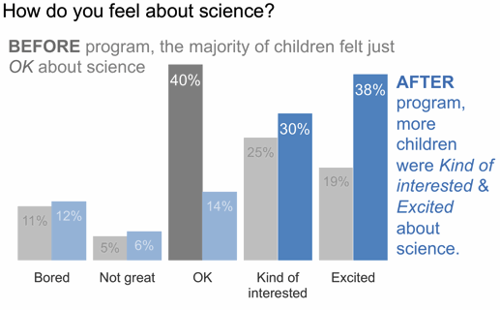
Survey Result Data – we will come back to this later
http://www.storytellingwithdata.com/blog/2014/06/alternatives-to-pies

Slide 10
Consulting for Context: Questions to Ask
What background information is relevant or essential?
Who is the audience or decision maker? What do we need to know about them?
What biases does our audience have that might make them supportive of or resistant to our message?
What data is available that would strengthen our case?
What would a successful outcome look like?
In a single sentence, what would you tell your audience?

Slide 11
ALY 6070 Communication and Visualization for Data Analytics
Bad vs. Good Data Visualizations from Story Telling with Data

Slide 12
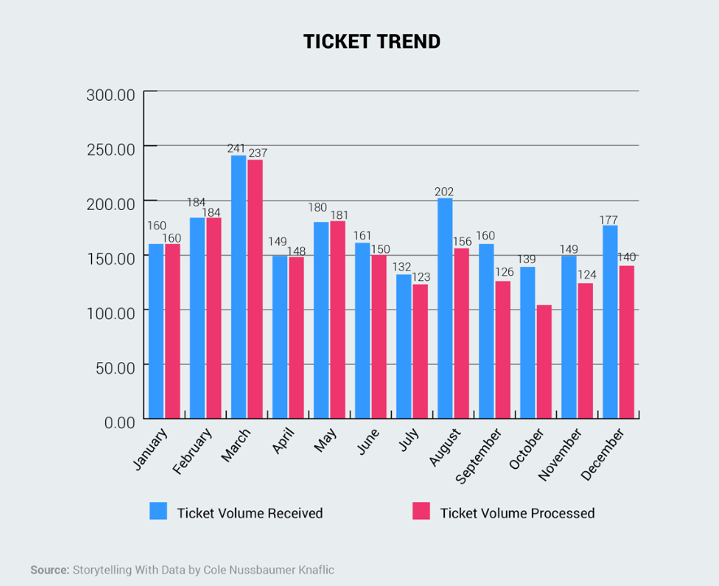
Example 1: Before
Is there a story here?

Slide 13
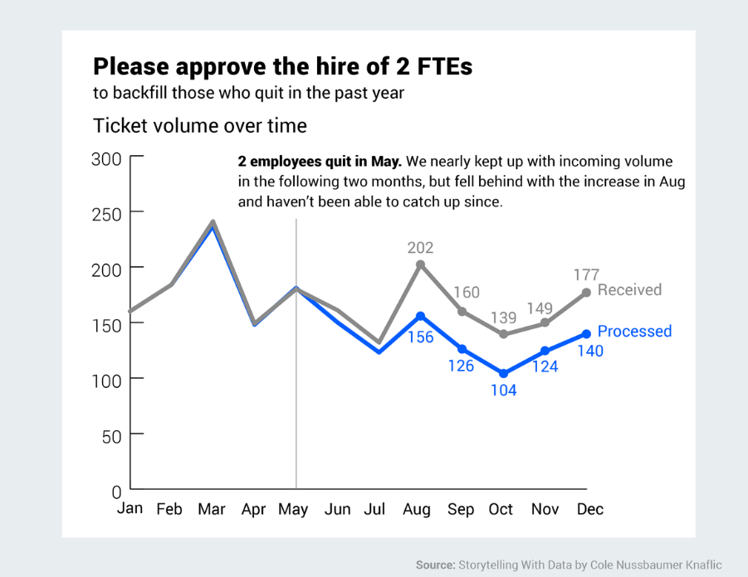
Example 1: After

Slide 14
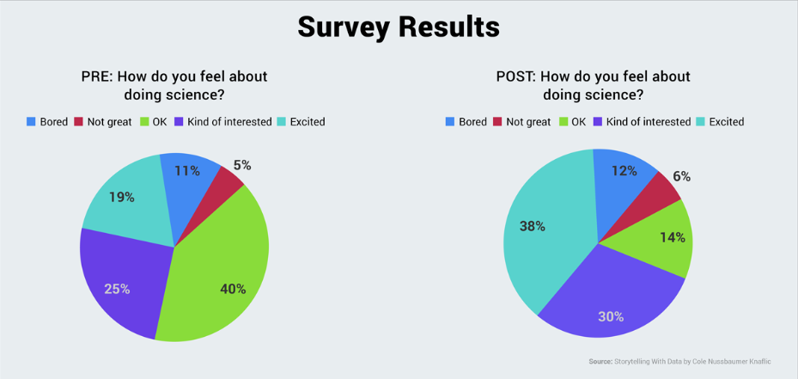
Example 2: Before
Cognitive Load: Too many colors compete for your attention
Pie graphs are difficult for the human eye to interpret (the author hates them)

Slide 15
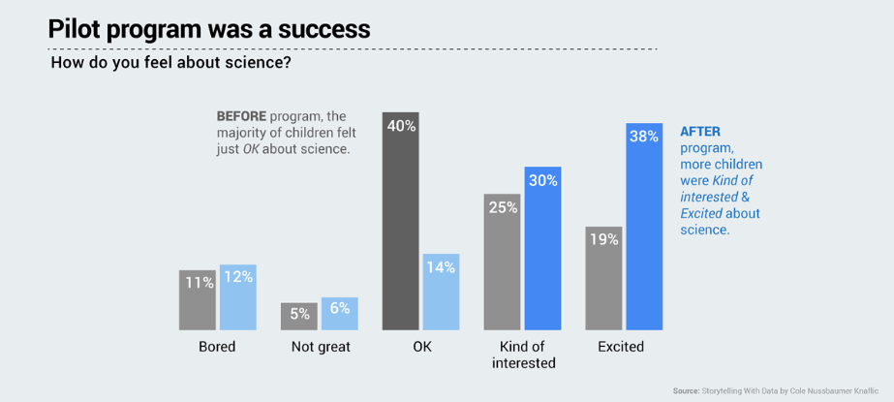
Example 2: After
Reduced Cognitive Load: Eye is drawn to the blue on the right. Story is communicated as text on the graph

Slide 16
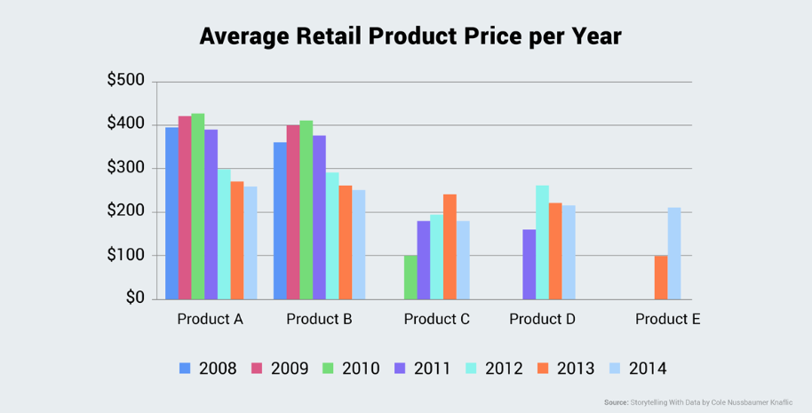
Example 3: Before
Be wary of Excel defaults! They are not your friend…

Slide 17
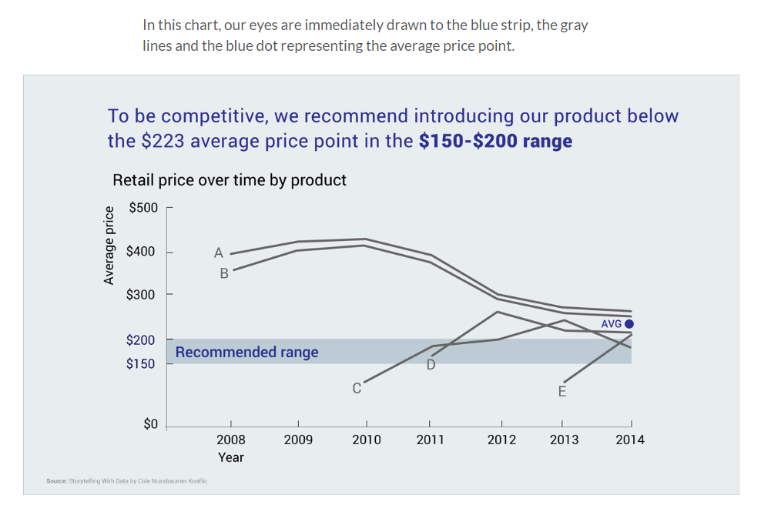
Example 3: After

